Slide 1

Siket Digitals
Modern websites for growing businesses.
Addis Ababa · Websites and web apps · Est. 2026

Slide 2
THE STUDIO
A small team that builds the site a business is judged by.
Siket Digitals is a digital solutions team in Addis Ababa. We build modern, responsive, high-quality websites for businesses and organizations.
We help a business establish a strong online presence through clean design, a clear way for people to get in touch, and a site that works properly on a phone.
The aim is simple: turn an idea into a professional digital experience that helps the business grow, reach its audience, and stand out.
01 Based in Addis Ababa
Local team, working with businesses that want a serious presence online.
02 Websites and web apps
Marketing sites, browser software, and redesigns of sites that have fallen behind.
03 Built to be used
Clear pages, fast loading, and a form or path that turns a visitor into a conversation.
Siket Digitals · Addis Ababa · Est. 2026
2 / 9

Slide 3
WHAT WE BUILD
Three kinds of work. One standard of finish.
01
Marketing websites
A site that explains the business clearly and gives people an obvious way to get in touch. This is the core of the studio: a page a customer can trust.
02
Web apps
Software that lives in the browser. That includes AI that can recommend things to each visitor, when the product needs more than a brochure.
03
Redesigns
An existing site rebuilt so it feels current, reads clearly, and works properly on a phone. The business keeps its name. The experience catches up.
Siket Digitals · Addis Ababa · Est. 2026
3 / 9

Slide 4
HOW A PROJECT GOES
Four steps, from the first conversation to launch.
01
02
03
04
Talk
We learn the business, who it serves, and what the site has to do.
Shape
We plan the pages and how the site should look and work.
Build
We design and develop it, and you see the work as it comes together.
Launch
We put it online and hand it over ready to use.
Siket Digitals · Addis Ababa · Est. 2026
4 / 9

Slide 5
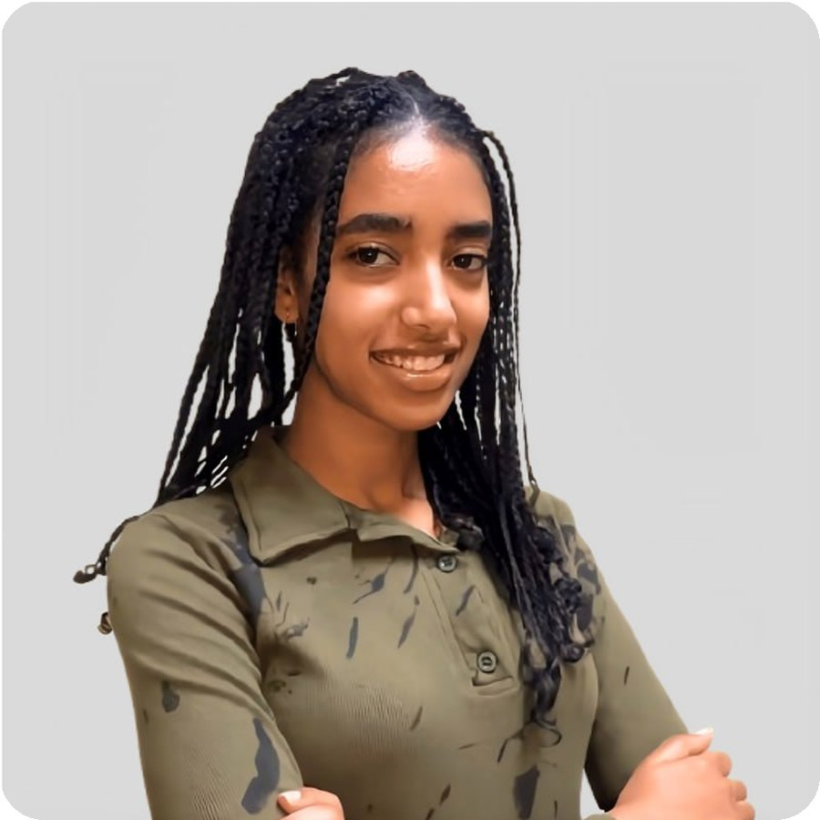
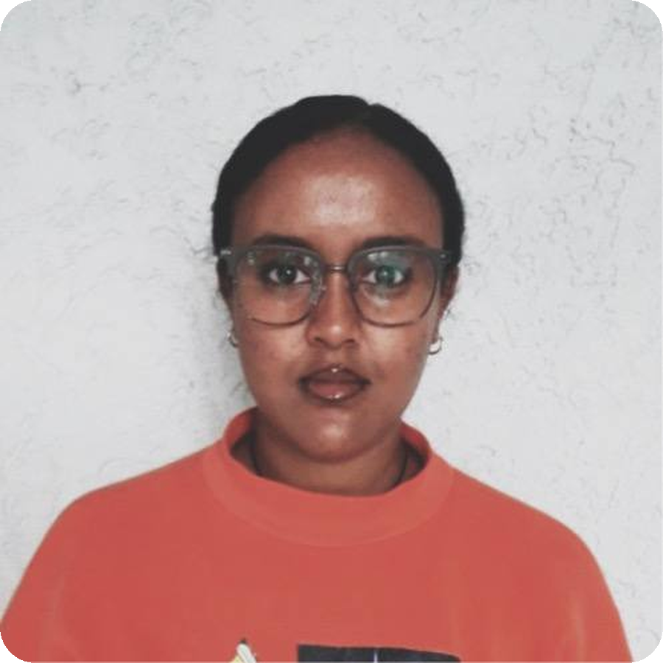
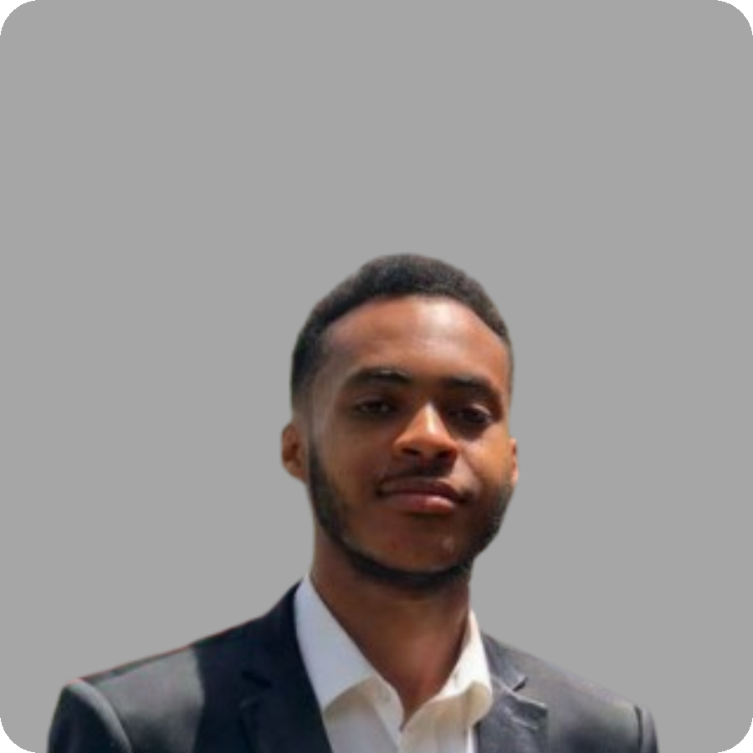
MEMBERS
The people who design, build, and keep it fast.
Mihret Daniel
Frontend developer
Uses React to build good-looking websites, and adds AI so a site can recommend things to each visitor.
Ribka Muluye
Frontend developer and web designer
Makes modern, aesthetic websites from the first layout to the finished interface, shaped around each client.
Sofoniyas Tekalegn
Backend developer
Creates well-structured databases, secure APIs, and the logic that keeps data safe and pages fast.
Siket Digitals · Addis Ababa · Est. 2026
5 / 9

Slide 6
BRAND COLORS
Four colors. Use them the same way every time.
Paper
Ink
Teal
Orange
#E6E0D1
The base. Newsprint, not pure white. Use it for pages, slides, and documents.
#1A1917
Text, rules, and dark backgrounds. Headlines and body copy live in ink.
#0B6E68
The S in the logo. Links, roles, and small accents. Never a full-page wash.
#E36A1E
The arrow. Buttons and one highlighted word. Button text stays ink, not white.
Siket Digitals · Addis Ababa · Est. 2026
6 / 9

Slide 7
THE LOGO
One mark. Two correct placements.
On ink. Set the name beside it in Georgia.
On paper, when the name is already on the page.
Siket Digitals · Addis Ababa · Est. 2026
7 / 9

Slide 8
USING THE LOGO
Keep the mark intact. Do not invent a second one.
Do
Use the official file. Do not redraw the S or the arrow.
Leave clear space around the mark, about the height of the arrow tip.
Place the S on ink with the name beside it, or the S alone on paper.
Keep orange for the arrow and teal for the S.
Do not
Do not stretch, rotate, outline, or add a shadow.
Do not recolor the mark or swap orange and teal.
Do not place it on a photograph or a busy pattern.
Do not set the wordmark in a different typeface.
Siket Digitals · Addis Ababa · Est. 2026
8 / 9

Slide 9
Start a project
Tell us about the business and what the site has to do. We reply from the studio inbox.
EMAIL
siketdigitals@gmail.com
PHONE
0937 591 141
PHONE
0978 695 556
PHONE
0909 905 340
LINKEDIN
linkedin.com/company/siket-digital
CITY
Addis Ababa

